Slide 1
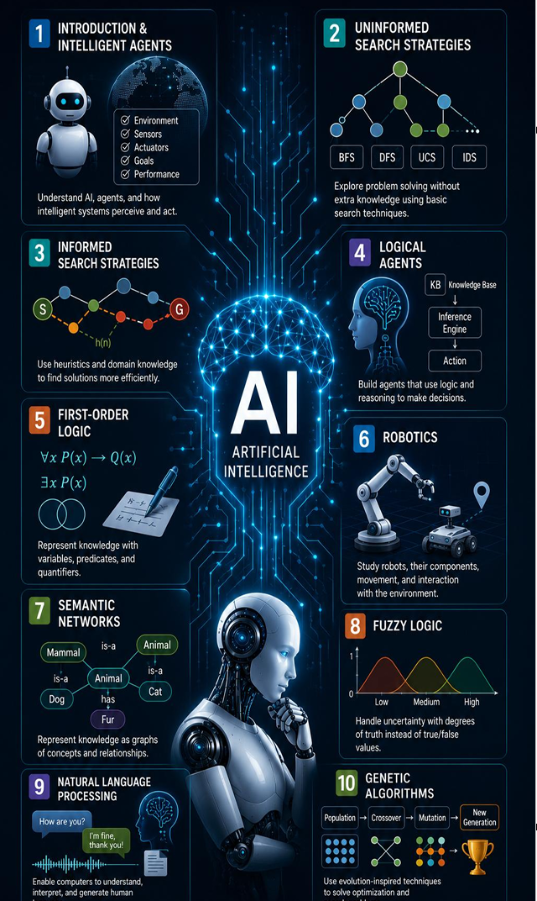

Insert relevant picture related to the topic
TGB2013/TFB2073/TEB2023_092 : Artificial Intelligence
WEEK 06
Search Engineering: Package, Tests, CLI and Benchmark
DEPARTMENT OF COMPUTING
FACULTY OF SCIENCE, MANAGEMENT & COMPUTING
© 2026 INSTITUTE OF TECHNOLOGY PETRONAS SDN BHD
All rights reserved. No part of this document may be reproduced, stored in a retrieval system or transmitted in any form or by any means (electronic, mechanical, photocopying, recording or otherwise) without the permission of the copyright owner.

Slide 2
RECAP FROM PREVIOUS LECTURE
Lab 1: uninformed search
1.1 BFS: fewest hops
1.2 UCS: lowest total cost
Lab 2: heuristic search
2.1 GBFS: very fast, not always optimal
2.2 A*: same cost as UCS, about 96% fewer expansions
Haversine heuristic is admissible (never overestimates)
Today: turn script code into a reusable toolkit

Slide 3
LEARNING OUTCOMES
Explain why search code is packaged in utils/
Run automated tests with pytest
2.1 Interpret “8 passed”
2.2 Explain what each test checks
Use the command-line interface
3.1 Run python -m utils with an algorithm, start and goal
3.2 Compare CLI output with the Lab 2 result
Benchmark four algorithms on ten routes

Slide 4
TOPIC
The pluggable frontier
One Interface, Five Algorithm
Separate Responsibilities
Automated Tests
Command-Line Interface
Benchmark

Slide 5
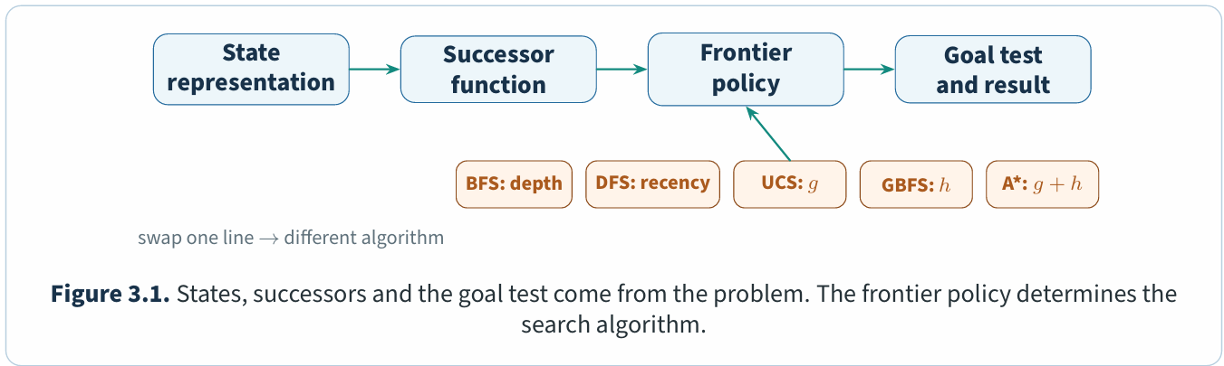
The pluggable frontier
The graph supplies states and successors; the query supplies the goal test. The frontier policy determines the algorithm (Figure 3.1)
In utils/core.py, BFS and DFS use pop left and pop, respectively. UCS, GBFS and A⋆ wrap best_first, whose mode selects the priority. Weighted A⋆ reuses it with the heuristic multiplied by 1.5.

Slide 6
Topic 1 - One Interface, Five Algorithm
Every algorithm returns SearchResult
Seven fields
2.1 found, path, hops, path_cost_km
2.2 expanded, max_frontier, runtime_ms
Why it matters
3.1 One loop can benchmark every algorithm
3.2 Results are directly comparable
Toy graph: BFS/DFS cost 7, UCS/GBFS/A* cost 6

Slide 7
Topic 2 - Separate Responsibilities
utils/ is a Python package
Logic and data
2.1 core.py: five algorithms, knows nothing about airports
2.2 openflights.py: load, clean, compute distances
Interface and checks
3.1 main.py: command line; plotting.py: charts
3.2 test_search.py: tests; init.py: exports
Change one module without breaking the others

Slide 8
Topic 3 - Automated Tests
Command: python -m pytest utils -q
Eight tests cover
2.1 start = goal, unreachable goal, cycles
2.2 BFS vs UCS, frontier update, GBFS, negative cost
Why a five-state graph
3.1 Answer can be checked by hand
3.2 No dataset, runs in under one second
Expected result: 8 passed

Slide 9
Topic 4 - Command-Line Interface
python -m utils --algorithm astar --start KUL --goal KEF
Options
2.1 --algorithm: bfs, dfs, ucs, gbfs, astar
2.2 --start and --goal: IATA codes
Expected output
3.1 hops=4, cost=11,461.3 km, expanded=69
3.2 KUL -> HKT -> LED -> HEL -> KEF
Same answer as the Lab 2 script: one shared implementation

Slide 10
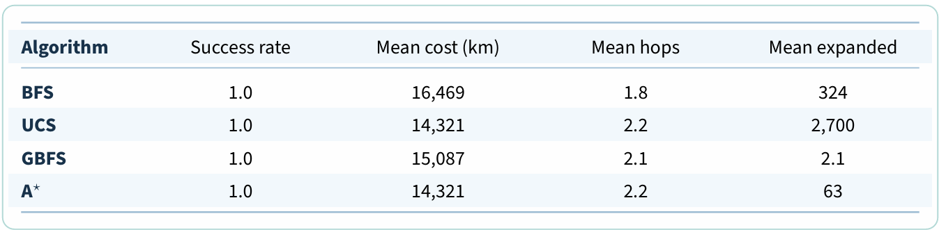
Topic 5 - Benchmark
Ten queries × four algorithms (BFS, UCS, GBFS, A*)
Metrics recorded
2.1 Success rate, mean cost, mean hops
2.2 Mean expanded states, median runtime
Expected findings
3.1 A* cost equals UCS on all 10 queries
3.2 GBFS costlier than UCS on 7 of 10 queries
A* is the best default among exact methods
BFS has the highest cost (optimises hops). GBFS expands least but is costlier. A* matches UCS with a fraction of the work.

Slide 11
Engagement and Activity
Hands-on: run Lab 3 in VS Code
Tasks
2.1 Run pytest and screenshot “8 passed”.
2.2 Run the CLI for a different route (e.g. JFK to SYD)
Discuss in pairs
3.1 Why is GBFS fastest but not the best?
3.2 Why does A* match UCS?
Make sure lab 03 script and files from results/lab03/ are pushed in the GitHub.

Slide 12
Check Your Understanding
Which one line differs between UCS and A* in best_first?
Why is path_cost_km recomputed from the returned path?
What is the counter in the heap tuple for?
Why do tests use a five-state graph, not the airline network?
Why is “7 of 10” more informative than the mean cost gap?

Slide 13
SUMMARY
Packaged code is reusable and testable
Tests prove correctness without any dataset
2.1 8 tests, under one second
2.2 CLI and python file share one implementation
Benchmark shows the trade-off
3.1 UCS: optimal but slow; GBFS: fast but risky
3.2 A*: optimal and fast
Next: Lab 4, Fuzzy Logic and ANFIS

Slide 14
THANK YOU
Farahida Hanim Bt Mausor
DEPARTMENT OF COMPUTING
FIZA_24004757@UTP.EDU.MY
Lab 01-01-10: Data Analytic Lab

